Slide 1
Review of learning 5

Slide 2

Multiple choice (3)
A number has 3 ones, 5 tenths, 4 hundredths and 9 thousandths.
Which letter matches this number?
9453 9.453 53.49 3.549
A
B
C
D
Notes:
This question connects to the content in the developing number sense activity (Activity 5)
Syllabus focus area:
Represents numbers A: Decimals and Percentages

Slide 3

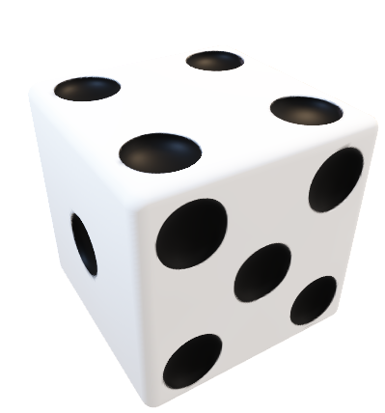
Short response (17)
Jordie needs to roll a ‘6’ to win a boardgame. Record the probability of him rolling
a ‘6’ as a fraction.
Notes:
Short response questions provide brisk paced questions focussing on review of current and previous content to support spaced and interleaved practice.
Syllabus focus area:
Chance A

Slide 4
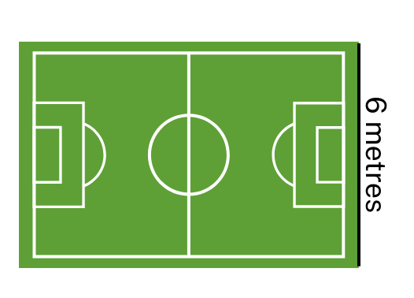
Short response (18)
A soccer field has an area of 486 square metres. One side (the width) measures 6 metres.
What is the length of the soccer field?
Notes:
Short response questions provide brisk paced questions focussing on review of current and previous content to support spaced and interleaved practice.
Syllabus focus area:
Two-dimensional spatial structure A: Area

Slide 5
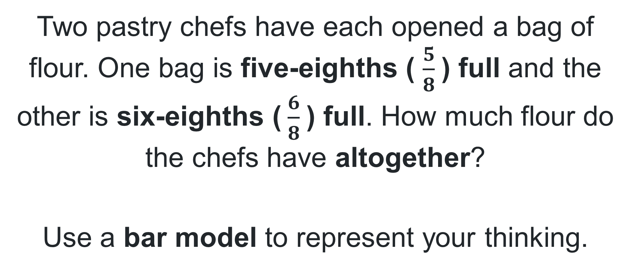
Short response (19)
Two pastry chefs have each opened a bag of flour. One bag is five-eighths ( $\frac{5}{8}$) full and the other is six-eighths ($\frac{6}{8}$) full. How much flour do the chefs have altogether?
Use a bar model to represent your thinking.
Notes:
Short response questions provide brisk paced questions focussing on review of current and previous content to support spaced and interleaved practice.
Syllabus focus area:
Representing quantity fractions A

Slide 6
Short response (20)
Is 3 kg 250 g the same as 3.25 kg?
Record your reasoning.
Notes:
Short response questions provide brisk paced questions focussing on review of current and previous content to support spaced and interleaved practice.
Syllabus focus area:
Non-spatial measure A: Mass

Slide 7

Activity 5 – recognise that the place value system can be extended beyond hundredths (1)
4.329
With a partner, identify and record:
the value of each of the digits in the number
the number that is one thousandth larger
the number that is one thousandth smaller.
Notes:
This is a developing number sense activity.
Number sense refers to a deep understanding of numbers, including their magnitude, relationships, and the effects of operations on them. It supports fluency and understanding, estimation, flexible thinking, and efficient problem-solving. Number sense activities 1–4 ‘activate’ prior number knowledge and support the learning of new content in the unit. Number sense activities 5–8 ‘loop’ back and provide opportunity for spaced practice with concepts and procedures covered in previous units.
Syllabus focus area:
Represents numbers A: Decimals and percentages
Recognise that the place value system can be extended beyond hundredths (1)
This resource corresponds to Resource 21 – place value chart in Stage 3 Year A Unit 18.
Display the number 4.329 on the board.
Students work with a partner to determine and record the value of each of the digits in the number. For example, the 4 has a value of 4 ones, the 3 has a value of 3 tenths, the 2 has a value of 2 hundredths and the 9 has a value of 9 thousandths.
Select students at random to share their thinking. Provide feedback to students in relation to the place value of each of the digits. Revisit this learning as required.
Display Resource 21 – place value chart. Provide each student with a copy.
Model how to identify and record the number that is one thousand times larger than the number 4.329.
Students use Resource 21 – place value chart to identify and record the numbers that are one thousand times larger and one thousand times smaller than the given numbers.
Students share their work with a partner to gain peer-feedback. They refer to the learning intention and success criteria to determine the success of their partner’s work. Students use sentence stems to give feedback, for example:
Shall we check together that … (the order of the digits in this smaller number is different to the original number)?
I can see that … (this number is one thousand times larger than the original number).

Slide 8
Review of learning 6

Slide 9
True or false (3)
One hundredth and 7 thousandths is equivalent to 0.017
True | False
Notes:
The question on this slide connects to the content being explored in the developing number sense activity (Activity 6)
Syllabus focus area:
Represents numbers A

Slide 10
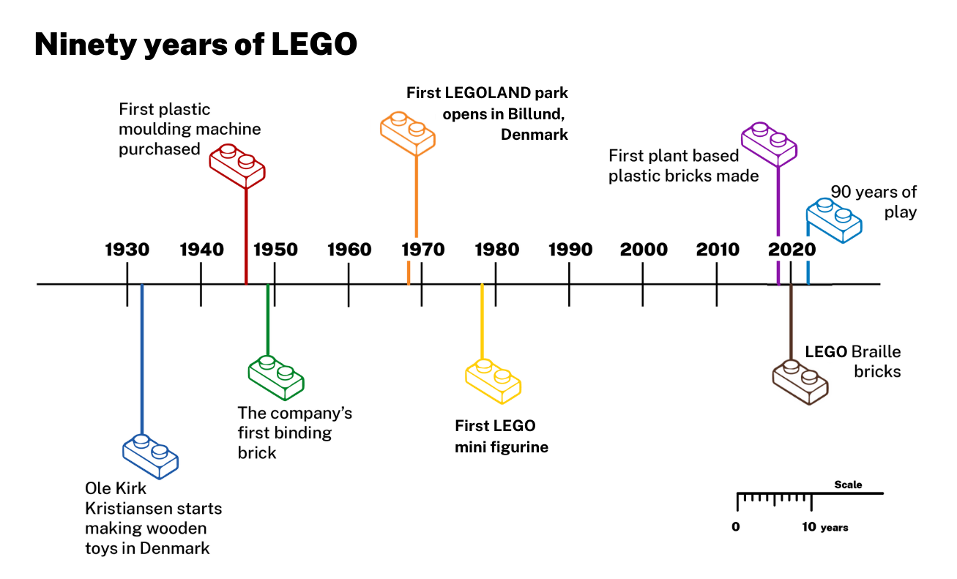
Short response (5)
Which decade on the timeline had more than one important event occur?
Notes:
Short response questions provide brisk paced questions focussing on review of current and previous content to support spaced and interleaved practice.
Syllabus focus area:
Data A

Slide 11
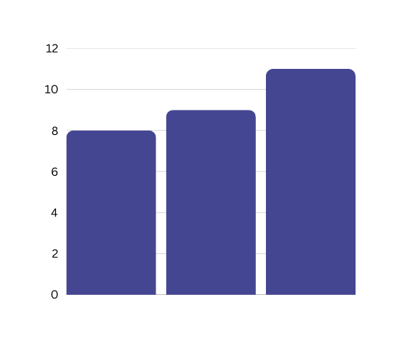
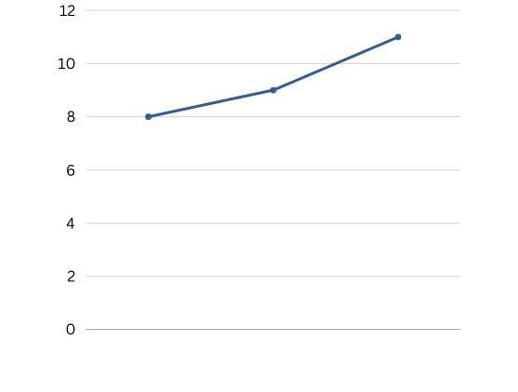
Short response (21)
Which type of data display is best suited to show the height of a plant’s growth over time? Explain your reasoning.
column graph line graph
11
11
Notes:
Short response questions provide brisk paced questions focussing on review of current and previous content to support spaced and interleaved practice.
Syllabus focus area:
Data B

Slide 12
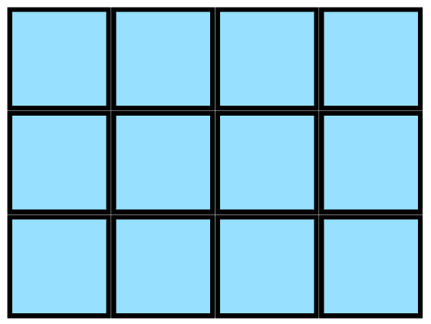
Short response (22)
This is the top view of a prism made of cubic centimetres (cm³). The prism has 5 layers.
What is the volume of the prism?
Notes:
Short response questions provide brisk paced questions focussing on review of current and previous content to support spaced and interleaved practice.
Syllabus focus area:
Three-dimensional spatial structure B: Volume

Slide 13
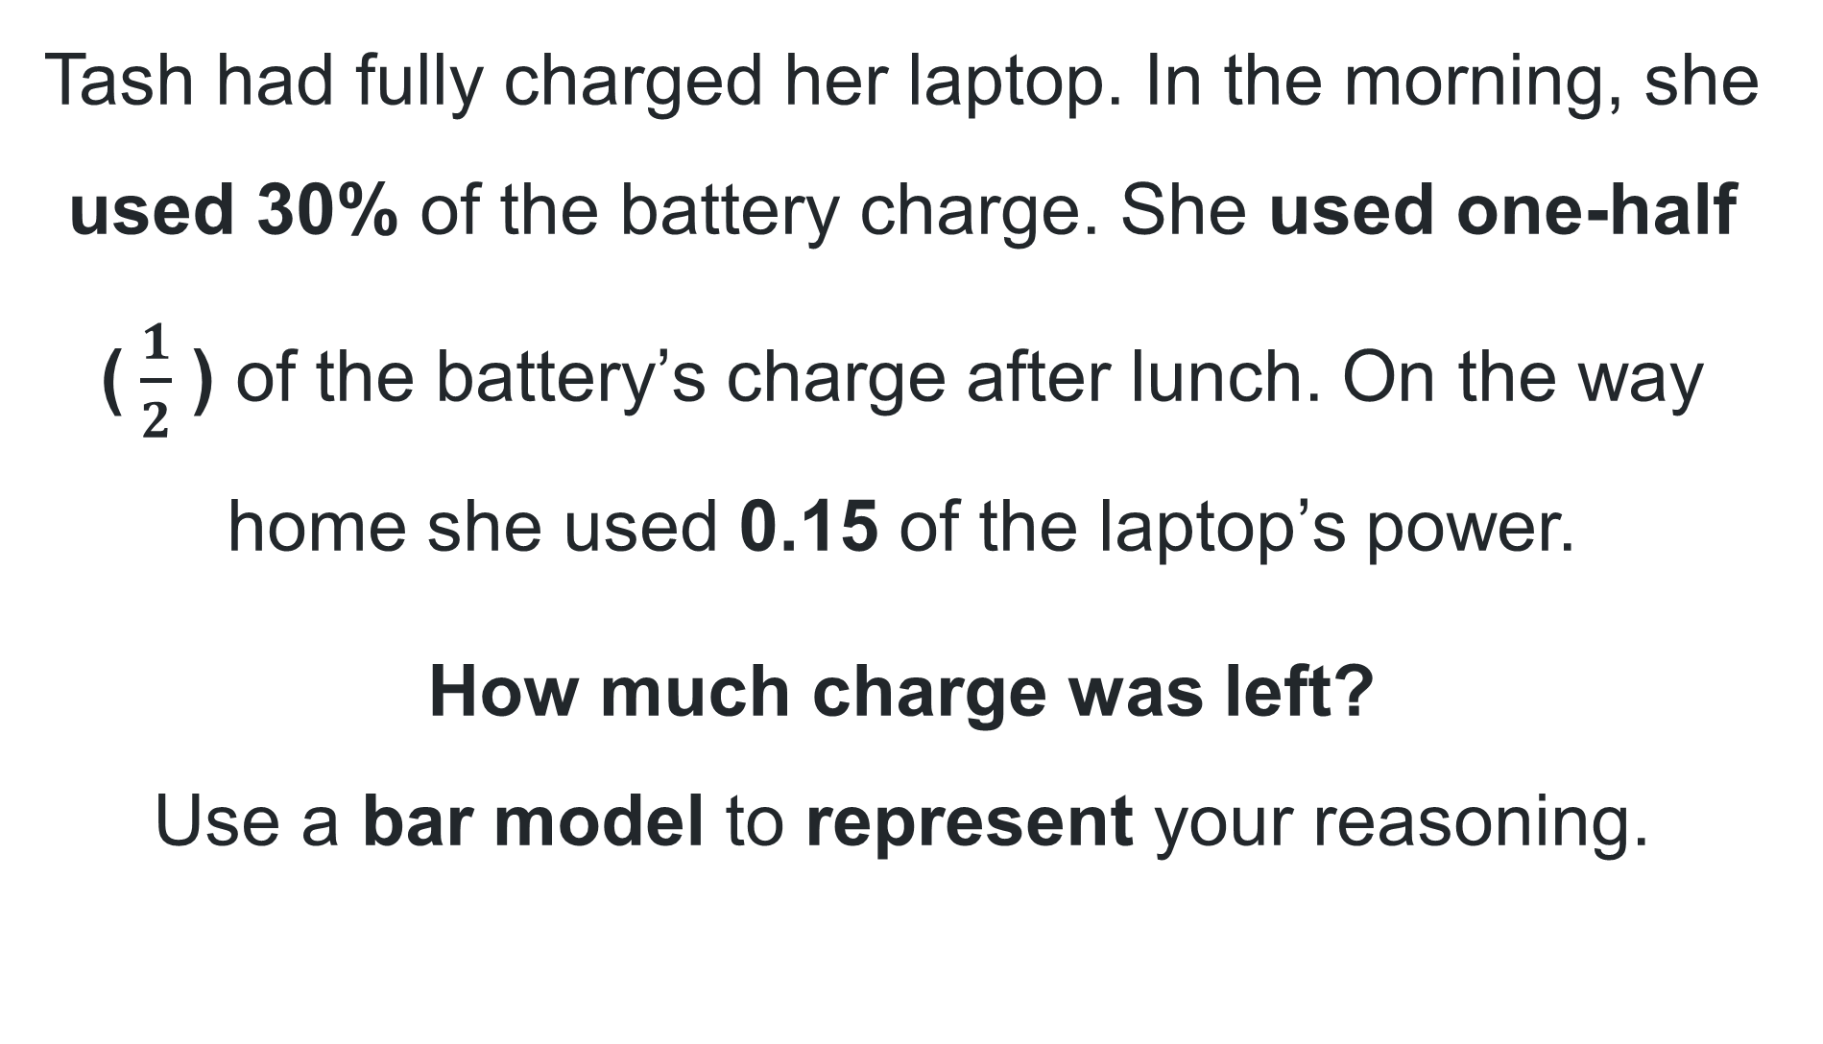
Short response (23)
Tash had fully charged her laptop. In the morning, she used 30% of the battery charge. She used one-half ($\frac{1}{2}$ ) of the battery’s charge after lunch. On the way home she used 0.15 of the laptop’s power.
How much charge was left?
Use a bar model to represent your reasoning.
Notes:
Short response questions provide brisk paced questions focussing on review of current and previous content to support spaced and interleaved practice.
Syllabus focus area:
Representing quantity fractions A

Slide 14
Short response (24)
Record the name of this 3D object.
Which of the object’s properties did you use to support your reasoning?
Notes:
Short response questions provide brisk paced questions focussing on review of current and previous content to support spaced and interleaved practice.
Syllabus focus area:
Three-dimensional spatial structure A: 3D Objects

Slide 15
Activity 6 – recognise that the place value system can be extended beyond hundredths (2)
4
6
0
Ones | Tenths | Hundredths | Thousandths
0
0
0
0
0
Use the numerals 4, 6 and 0 to make 5 decimal numbers.
Each numeral can only be used once in each decimal, for example, 0.406
Arrange the 5 decimal numbers in ascending order.
Notes:
This is a developing number sense activity.
Number sense refers to a deep understanding of numbers, including their magnitude, relationships, and the effects of operations on them. It supports fluency and understanding, estimation, flexible thinking, and efficient problem-solving. Number sense activities 1–4 ‘activate’ prior number knowledge and support the learning of new content in the unit. Number sense activities 5–8 ‘loop’ back and provide opportunity for spaced practice with concepts and procedures covered in previous units.
Syllabus focus area:
Represents numbers A: Decimals and percentages
Recognise that the place value system can be extended beyond hundredths (2)
This resource corresponds to Resource 22 – ascending order in Stage 3 Year A Unit 18.
Note: the role of zero as a place holder assists in understanding how we say and write decimals. The number 0.2 has the same value as 0.20 and the number 2 has the same value as 2.0. In measurement, zeros at the end of a decimal have a different meaning as they are used to record precision. For example, a measurement recorded as 0.2 seconds is measured in tenths of a second whereas a measurement recorded as 0.20 seconds is measured in hundredths of a second.
Display the numbers 0, 5 and 9 on the board. Model how to create the smallest and largest numbers as decimals to the thousandths using 0 in the ones place. For example, 0.950 is the largest number that can be created, and 0.059 is the smallest number that can be created.
Display Resource 22 – ascending order.
Students make a list of decimals in ascending order using the numerals 0, 4 and 6 after the decimal point. Each numeral must be used and can only be used once. For example, the smallest decimal is 0.046 and the largest decimal is 0.640.
Select students at random to share and explain solutions, referring to the place value of digits. Ask the following questions:
How do you know your numbers are in ascending order?
What strategy was most helpful?
How did you check your solutions?
If a digit was repeated, such as 0, 4 and 4, would the task be easier or more difficult?
For an additional challenge, invite students to use the digits 6, 4, 0, 0 and write all the decimal numbers in ascending order from 0.046 to 6.400.

Slide 16
Review of learning 7

Slide 17
Multiple choice (4)
Which sequence correctly shows the
decimal numbers in ascending order?
A
1.083, 0.183, 3.180, 8.013
B
0.183, 1.083, 8.013, 3.180
C
0.183, 1.083, 8.013, 3.180
D
3.180, 1.083, 0.183, 8.013
Notes:
This question connects to the content in the developing number sense activity (Activity 7)
Syllabus focus area:
Represents numbers A: Decimals and percentages

Slide 18
Short response (25)
Piper is collecting categorical data about favourite foods. She is planning to use this survey question:
Would this question provide categorical data about favourite foods? Explain your reasoning.
How many servings of fruit do you eat on a school day?
Notes:
Short response questions provide brisk paced questions focussing on review of current and previous content to support spaced and interleaved practice.
Syllabus focus area:
Data A

Slide 19
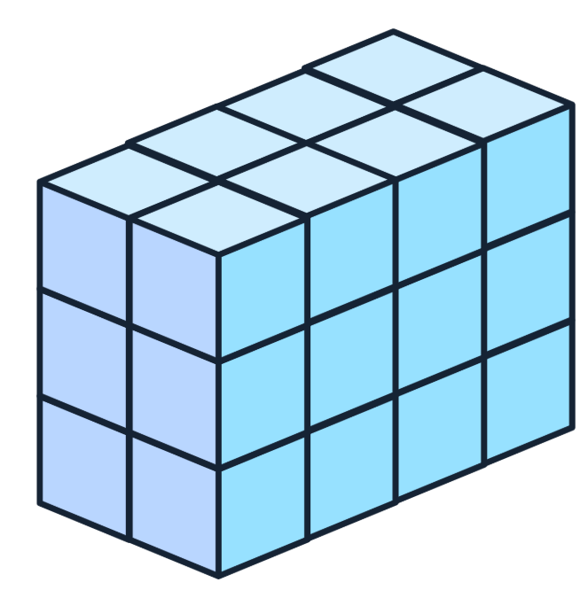
Short response (26)
Calculate and record the volume of the rectangular prism in cubic centimetres (cm³).
Notes:
Short response questions provide brisk paced questions focussing on review of current and previous content to support spaced and interleaved practice.
Syllabus focus area:
Three-dimensional spatial structure B: Volume

Slide 20
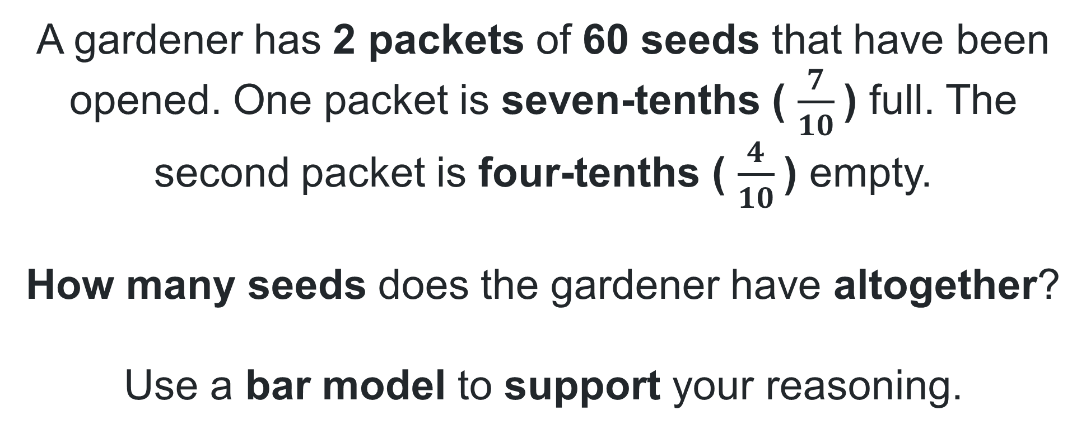
Short response (27)
A gardener has 2 packets of 60 seeds that have been opened. One packet is seven-tenths ( $\frac{7}{10}$) full. The second packet is four-tenths ( $\frac{4}{10}$) empty.
How many seeds does the gardener have altogether?
Use a bar model to support your reasoning.
Notes:
Short response questions provide brisk paced questions focussing on review of current and previous content to support spaced and interleaved practice.
Syllabus focus area:
Representing quantity fractions A

Slide 21
Short response (28)
Estimate the length of a swimming pool?
Explain your reasoning.
Notes:
Short response questions provide brisk paced questions focussing on review of current and previous content to support spaced and interleaved practice.
Syllabus focus area:
Geometric measure A: Length

Slide 22
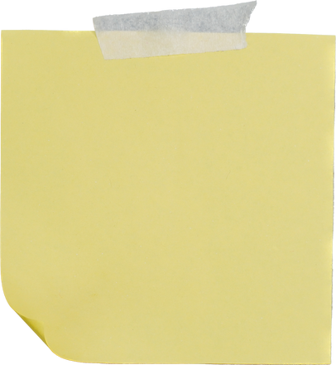

Activity 7 – make connections between benchmark fractions, decimals and percentages (1)
Some of these sticky notes fell off.
Write in where each number or percentage should be placed.
0.9
1
100%
1.911
0.951
0.98
99%
1.002
0.93
0.940
0.96
0.919
0.901
0.900
95%
0.917
$$\frac{9}{10}$$
0.911
Notes:
This is a developing number sense activity.
Number sense refers to a deep understanding of numbers, including their magnitude, relationships, and the effects of operations on them. It supports fluency and understanding, estimation, flexible thinking, and efficient problem-solving. Number sense activities 1–4 ‘activate’ prior number knowledge and support the learning of new content in the unit. Number sense activities 5–8 ‘loop’ back and provide opportunity for spaced practice with concepts and procedures covered in previous units.
Syllabus focus area:
Represents numbers A: Decimals and percentages
Make connections between benchmark fractions, decimals and percentages (1)
This resource corresponds to Resource 23 – What’s missing? in Stage 3 Year A Unit 18.
Display Resource 23 – What’s missing? Provide each student with a copy.
Explain that the labelled sticky notes fell off the number line and need to be placed back on, in order.
Use a think-aloud to draw attention to the sticky note with 90%, and model where this would be placed on the number line, explaining that 90% is the same as 9/10.
Instruct students to read the number aloud as they place it on the number line. Remind students that the decimal 0.918 is read as ‘nine hundred and eighteen thousandths’, not ‘zero point nine one eight’.
Students work with a partner to identify and record each of the numbers, percentages and fractions on the number line.
Ask:
How can you check that you have placed the numbers in the correct order along the number line?
Can you identify the place value for each of the digits in a chosen number, for example, 0.901?
Did you think differently to place the fractions and percentages?
Did you identify and record all the numbers on the number line? Why or why not?
Select students at random to share their thinking. Repeat with other students.
Revisit learning as required through providing explicit feedback in connection with the learning intentions and success criteria.

Slide 23
Review of learning 8

Slide 24
True or false (4)
One thousandth is larger than
one hundredth.
True | False
Notes:
The question on this slide connects to the content being explored in the developing number sense activity (Activity 8)
Syllabus focus area:
Represents numbers A: Decimals and percentages

Slide 25
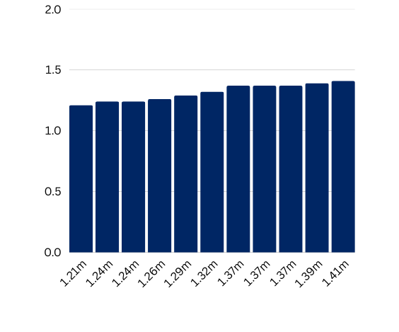
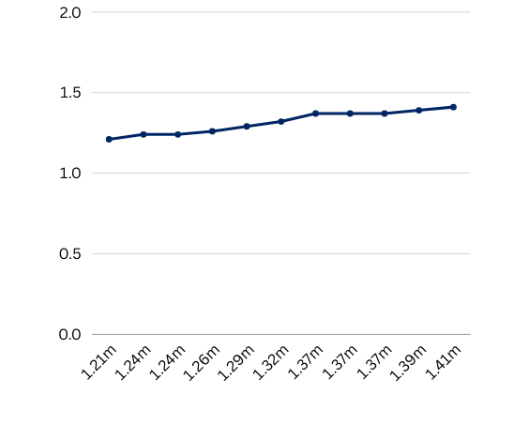
Short response (29)
This is a data display comparing the school’s high jump records. Which would be least helpful for Stage 2 students to see the change over time? Explain your reasoning.
Year | Height jumped
2015 | 1.21m
2016 | 1.24m
2017 | 1.24m
2018 | 1.26m
2019 | 1.29m
2020 | 1.32m
2021 | 1.37m
2022 | 1.37m
2023 | 1.37m
2024 | 1.39m
2025 | 1.41m
column graph line graph table
Notes:
Short response questions provide brisk paced questions focussing on review of current and previous content to support spaced and interleaved practice.
Syllabus focus area:
Data A

Slide 26
Short response (30)
Use the information in the table to find the volume of each rectangular prism
in cubic metres (m³).
Base | 5 layers | 10 layers | 100 layers
9 m 6m
Notes:
Short response questions provide brisk paced questions focussing on review of current and previous content to support spaced and interleaved practice.
Syllabus focus area:
Three-dimensional spatial structure B: Volume

Slide 27
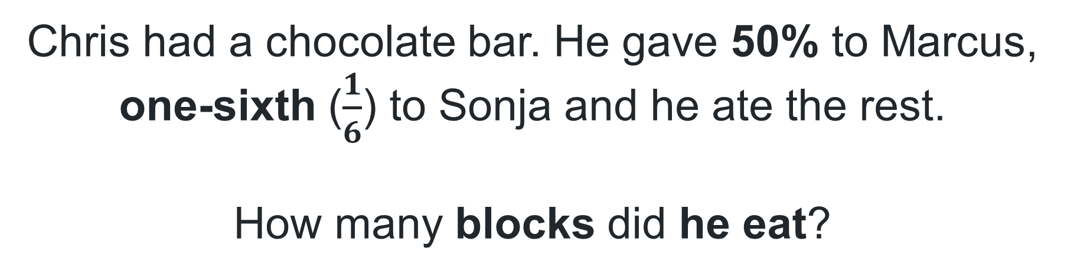
Short response (31)
Chris had a chocolate bar. He gave 50% to Marcus, one-sixth ($\frac{1}{6}$) to Sonja and he ate the rest.
How many blocks did he eat?
Notes:
Short response questions provide brisk paced questions focussing on review of current and previous content to support spaced and interleaved practice.
Syllabus focus area:
Representing quantity fractions B

Slide 28
Short response (32)
It’s morning and an analog clock has the minute hand pointing to the 2, with the hour hand pointing to just after the 10.
What is the time?
Record your answer in 24-hour time.
Notes:
Short response questions provide brisk paced questions focussing on review of current and previous content to support spaced and interleaved practice.
Syllabus focus area:
Non-spatial measure A: Time

Slide 29
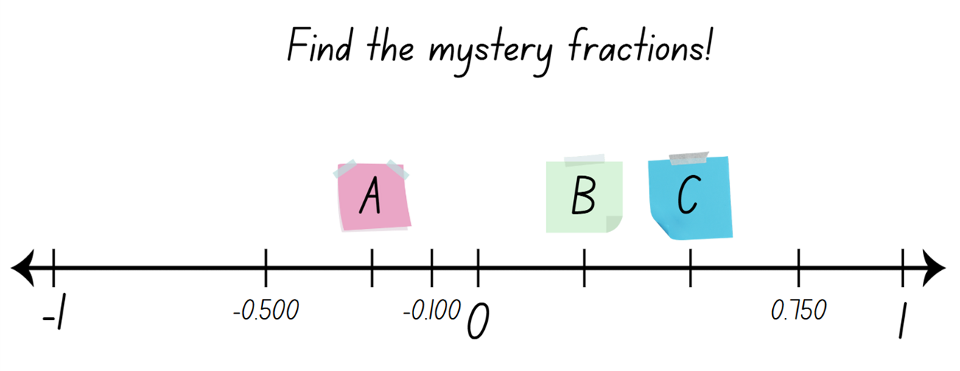
Activity 8 – make connections between benchmark fractions, decimals and percentages (2)
Notes:
This is a developing number sense activity.
Number sense refers to a deep understanding of numbers, including their magnitude, relationships, and the effects of operations on them. It supports fluency and understanding, estimation, flexible thinking, and efficient problem-solving. Number sense activities 1–4 ‘activate’ prior number knowledge and support the learning of new content in the unit. Number sense activities 5–8 ‘loop’ back and provide opportunity for spaced practice with concepts and procedures covered in previous units.
Syllabus focus areas:
Represents numbers A: Decimals and percentages
Represents numbers B: Decimals and percentages
Make connections between benchmark fractions, decimals and percentages (2)
This resource corresponds to Resource 24 – mystery fractions in Stage 3 Year A Unit 18.
Display Resource 24 – mystery fractions. Provide each student with a copy.
Explain that this number line has 3 unidentified marks: A, B and C. The number line also has the numbers -0.100, -0.500, 0, 0.750 and 1 marked. Explain that the missing numbers are fractions.
Students turn and talk with their partner about how they might determine the mystery fractions and what clues they might use to help them.
Select students at random to share their thinking with the class. Repeat with additional students.
Students work with their partner to determine the missing fractions.
Check for understanding by asking students to display their work. Scan for student understanding, give feedback and clarify thinking as required.

Slide 30
Double Venn diagram
Object 1
Object 2
Features similar to both objects
Features of object 1
Features of object 2

Slide 31
Frayer
Definition
Facts/Characteristics
Word, term, concept
Examples
Non-examples

Slide 32
Spider map
Idea
Subject

Slide 33
Cline
Concept 1
Concept 2
Word
Word
Word
Word
Word
Word
Word
Word
Word
Word
Word

Slide 34
Compare and contrast

Slide 35
Multiple choice (5)
A
B
C
D

Slide 36
Multiple choice (6)
A
B
C
D

Slide 37
References
This presentation contains NSW Curriculum and syllabus content. The NSW Curriculum is developed by the NSW Education Standards Authority. This content is prepared by NESA for and on behalf of the Crown in the right of the State of New South Wales. The material is protected by Crown copyright.
Please refer to the NESA Copyright Disclaimer for more information https://educationstandards.nsw.edu.au/wps/portal/nesa/mini-footer/copyright.
NESA holds the only official and up-to-date versions of the NSW Curriculum and syllabus documents. Please visit the NSW Education Standards Authority (NESA) website https://educationstandards.nsw.edu.au/wps/portal/nesa/home and the NSW Curriculum website https://curriculum.nsw.edu.au.
Mathematics K–10 Syllabus © NSW Education Standards Authority (NESA) for and on behalf of the Crown in right of the State of New South Wales, 2022.
National Numeracy Learning Progression © Australian Curriculum, Assessment and Reporting Authority (ACARA) 2010 to present, unless otherwise indicated. This material was downloaded from the Australian Curriculum website (National Numeracy Learning Progression) (accessed 21 March 2024) and was not modified.
ABC (Australian Broadcasting Corporation) (20 October 2020) 'World Statistics Day' [video], BTN (Behind the News), ABC website, accessed 30 April 2024.
Australian Academy of Science (2020) Data: Making Decisions, re(Solve): Maths by Inquiry website, accessed 26 March 2024.
ABS (Australian Bureau of Statistics) (1991) ‘Census Characteristics of Australia: 1991 Census of Population and Housing’, ABS, accessed 27 June 2024.
ABS (27 June 2017) Census reveals a fast changing, culturally diverse nation [media release], ABS, accessed 27 June 2024.
ABS (2021) Cultural diversity: Census, ABS webpage, accessed 27 June 2024.

Slide 38
References
This presentation contains NSW Curriculum and syllabus content. The NSW Curriculum is developed by the NSW Education Standards Authority. This content is prepared by NESA for and on behalf of the Crown in the right of the State of New South Wales. The material is protected by Crown copyright.
Please refer to the NESA Copyright Disclaimer for more information https://educationstandards.nsw.edu.au/wps/portal/nesa/mini-footer/copyright.
NESA holds the only official and up-to-date versions of the NSW Curriculum and syllabus documents. Please visit the NSW Education Standards Authority (NESA) website https://educationstandards.nsw.edu.au/wps/portal/nesa/home and the NSW Curriculum website https://curriculum.nsw.edu.au.
Gaslowitz L (n.d.) ‘How to spot a misleading graph – Lea Gaslowitz’, Lessons, TED-Ed website, accessed 4 April 2024.
NESA (NSW Education Standards Authority) (2022) ‘Glossary’, Mathematics K–10 Syllabus, NESA website, accessed 12 July 2024.
New Zealand Ministry of Education (n.d.) ‘Greedy Pig’, Resource Finder, NZ Maths website, accessed 3 April 2024.
Russo T (19 August 2020) 'The King’s Tax Maths Game' [video], Toby Russo, YouTube, accessed 4 April 2024.
SBS (2022) SBS Australian Census Explorer, SBS News website, accessed 26 March 2024.
Sullivan P and Lilburn P (2017) Open-ended Maths Activities: Using ‘Good’ Questions to Enhance Learning in Mathematics, Revised edn, Oxford University Press ANZ, Great Britain.
University of Cambridge (n.d.a) What Does Random Look Like?, NRICH website, accessed 2 April 2024.

Slide 39
References
This presentation contains NSW Curriculum and syllabus content. The NSW Curriculum is developed by the NSW Education Standards Authority. This content is prepared by NESA for and on behalf of the Crown in the right of the State of New South Wales. The material is protected by Crown copyright.
Please refer to the NESA Copyright Disclaimer for more information https://educationstandards.nsw.edu.au/wps/portal/nesa/mini-footer/copyright.
NESA holds the only official and up-to-date versions of the NSW Curriculum and syllabus documents. Please visit the NSW Education Standards Authority (NESA) website https://educationstandards.nsw.edu.au/wps/portal/nesa/home and the NSW Curriculum website https://curriculum.nsw.edu.au.
University of Cambridge (n.d.b) A Bit of a Dicey Problem, NRICH website, accessed 2 April 2024.
Van de Walle J, Karp K, Bay-Williams JM, Brass A, Bentley B, Ferguson S, Goff W, Livy S, Marshman M, Martin D, Pearn C, Prodromou T, Symons D and Wilkie K (2019) Primary and Middle Years Mathematics: Teaching Developmentally, 1st Australian edn, Pearson Education Australia, Melbourne.

Slide 40
Copyright
© State of New South Wales (Department of Education), 2025
The copyright material published in this resource is subject to the Copyright Act 1968 (Cth) and is owned by the NSW Department of Education or, where indicated, by a party other than the NSW Department of Education (third-party material).
Copyright material available in this resource and owned by the NSW Department of Education is licensed under a Creative Commons Attribution 4.0 International (CC BY 4.0) license.
This license allows you to share and adapt the material for any purpose, even commercially.
Attribution should be given to © State of New South Wales (Department of Education), 2025.
Material in this resource not available under a Creative Commons license:
the NSW Department of Education logo, other logos and trademark-protected material
Material owned by a third party that has been reproduced with permission. You will need to obtain permission from the third party to reuse its material.
Links to third-party material and websites
Please note that the provided (reading/viewing material/list/links/texts) are a suggestion only and implies no endorsement, by the New South Wales Department of Education, of any author, publisher, or book title. School principals and teachers are best placed to assess the suitability of resources that would complement the curriculum and reflect the needs and interests of their students.
If you use the links provided in this document to access a third party’s website, you acknowledge that the terms of use, including licence terms set out on the third-party’s website apply to the use which may be made of the materials on that third-party website or where permitted by the Copyright Act 1968 (Cth). The department accepts no responsibility for content on third-party websites.

